Slide 1
William Stallings
Computer Organization and Architecture
8th Edition
Chapter 1
Introduction

Slide 2
INTRODUCTION TO BASIC COMPUTER ARCHITECTURE
Architecture & Organization 1
TR 1.1.1
In describing computers, a distinction is often made between computer architecture and computer organization.
Architecture is those attributes visible to the programmer
  Instruction set, number of bits used for data representation, I/O mechanisms, addressing techniques.
  e.g. Is there a multiply instruction?
Organization is how features are implemented
  Control signals, interfaces, memory technology.
  e.g. Is there a hardware multiply unit or is it done by repeated addition?

Slide 3
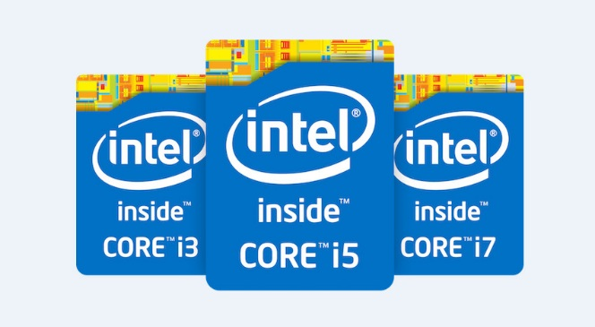
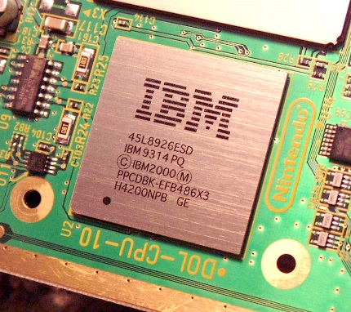
Architecture & Organization 2
TR 1.1.2
Many computer manufacturers offer a family of computer models, all with the same architecture but with differences in organization
All Intel x86 family share the same basic architecture
The IBM System/370 family share the
same basic architecture
This gives code compatibility
  At least backwards
Organization differs between different versions

Slide 4
Structure & Function
TR 1.1.3
Structure is the way in which components are interrelate to each other
Function is the operation of individual components as part of the structure

Slide 5
Function
TR 1.1.4
All computer functions are:
  Data processing
    The computer must be able to process data
  Data storage
  - Must be able to record the information in the
  storage medium
  3. Data movement
    Must be able to move data between itself and outside world
  4. Control
    There must be control of these three functions

Slide 6
Structure - Top Level
TR 1.1.6
There are four main structural components:
  Central Processing Unit (CPU)
    Controls the operation of the computer and performs its data processing functions
    Simply referred as processor
  Main Memory
    Stores data
  I/O
    Moves data between the computer and its external environment
  System Interconnection
    Some mechanism that provides for communication among CPU, main memory, and I/O

Slide 7
Structure - Top Level
TR 1.1.7
Peripherals
Computer
Central
Processing
Unit
Main
Memory
Computer
Systems
Interconnection
Input
Output
Communication
lines

Slide 8
Structure – The CPU
TR 1.1.8
There are four main structural components:
  Control Unit (CU)
    Controls the operation of the CPU and hence the computer
  Arithmetic And Logic Unit (ALU)
    Performs the computer’s data processing functions
  Registers
    Provides storage internal to the CPU
  CPU Interconnection
    Some mechanism that provides for communication among Control Unit, ALU, and Registers

Slide 9
Structure - The CPU
TR 1.1.9
CPU
Computer
Arithmetic
and
Login Unit
I/O
Registers
System
Bus
CPU
Internal CPU
Interconnection
Memory
Control
Unit

Slide 10
Structure - The Control Unit
TR 1.1.10
Control Unit
CPU
ALU
Sequencing
Login
Internal
Bus
Control
Unit
Control Unit
Registers and
Decoders
Registers
Control
Memory

Slide 11
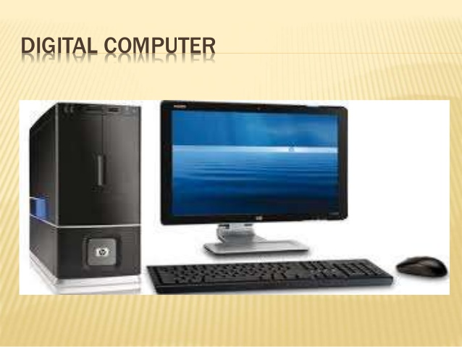
TYPES OF COMPUTERS
TR 1. 2.1
3 types of computers
  Digital Computer
  A computer that stores data in terms of digits (numbers) and proceeds in discrete steps from one state to the next.
  The states of a digital computer typically involve binary digits which may take the form of the presence or absence of magnetic markers in a storage medium (see memory), on-off switches or relays. In digital computers, even letters, words and whole texts are represented digitally.
  Access input data, process and produce output in digital form
  Two discrete states – 1/on/+ve
  and 0/off/-ve

Slide 12
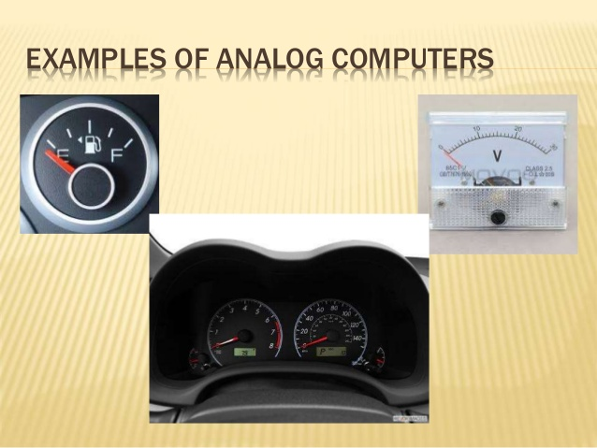
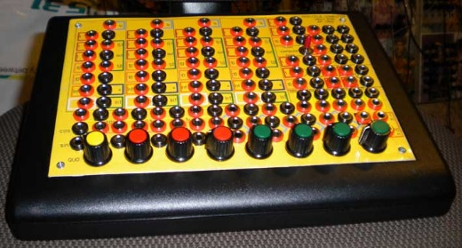
Types Of Computers (cont’d)
TR 1. 2. 2
  Analogue Computer
  A computer that represents data in terms of physical measures or quantities and proceeds along a continuum constituted by its components.
  Analog computers are especially suited for the solution of complex non-linear equations and for the simulation of multi-dimensional, parallel and continuous processes.
  Access input data, process and produce output in analogue form
  Example : computer to measure electricity, voltage, temperature and pressure

Slide 13
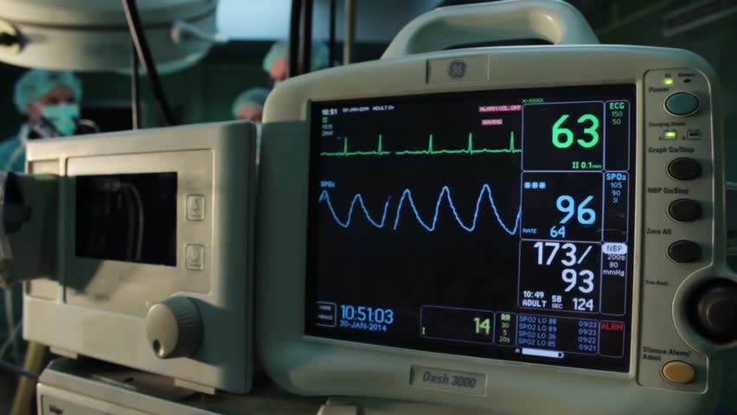
Types Of Computers (cont’d)
TR 1. 2. 3
  Hybrid Computer
  A combination of computers that are capable of inputting and outputting in both digital and analog signals.
  processes both analog and digital data
  A hybrid computer system setup offers a cost effective method of performing complex simulations.
  Eg : computer to measure heart beat in ICU in a hospital.

Slide 14
COMPUTER CLASSIFICATION
TR 1. 2. 4
In terms of size
  Microcomputer
    Small computer that can fit on a desktop or in one’s briefcase
    2 types of microcomputer
      Personal computer
      desktop, notebook, mobile computer, laptop, notebook, PDA
      Workstation
      expensive, powerful desktop machines used by engineers and scientist for sophisticated purposes
    Can perform input, processing, output and storage activities by itself.
    Used by home users, small and large business users, mobile users and power users.

Slide 15
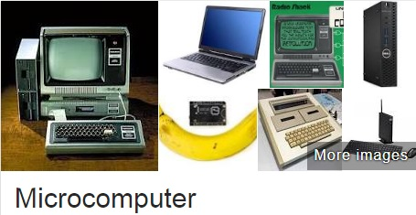

Slide 16
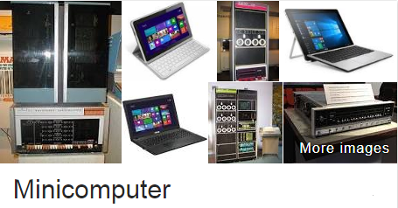
Computer classification (cont’d)
TR 1. 2. 5
  2. Minicomputer
  Can be shared among 40 users at the same time.
  More powerful and larger than a workstation.
  Act as a server in a network environment.
  Used by large business users and power users.

Slide 17
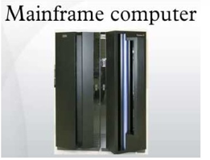
3. Mainframe Computer
  A large, expensive and very powerful computer.
  A huge capacity storage.
  Hundreds or thousands connected users simultaneously.
  Act as a server in a network environment.
  Used by large business users and power users.

Slide 18
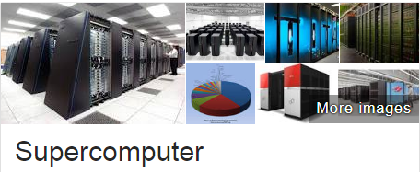
Computer classification (cont’d)
TR 1. 2. 6
4. Supercomputer
    Most powerful, the fastest, can process trillions of instructions.
    Capable of processing more than 64 billion instructions in a single second.
    Used for complex, sophisticated and mathematical calculations applications.
    Used by large business users and power users.

Slide 19
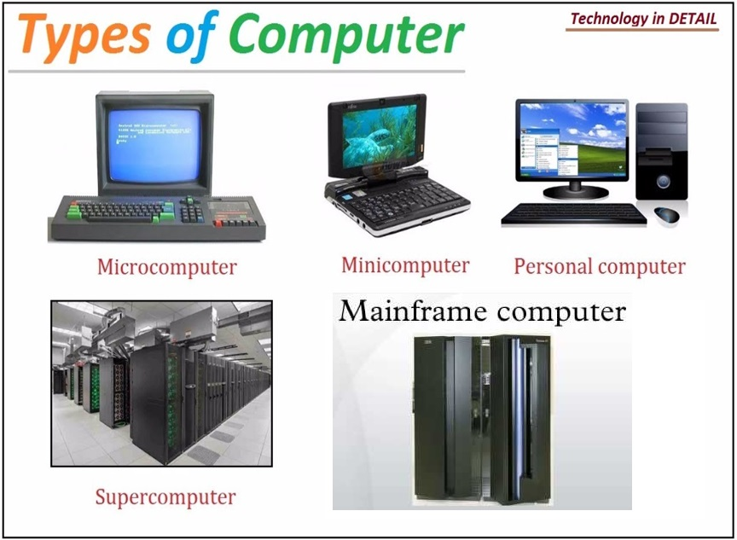

Slide 20
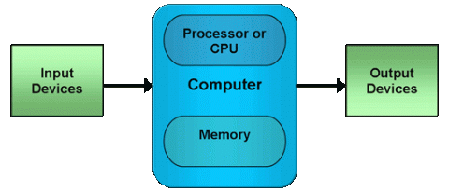
INTERCONNECTION STRUCTURE
TR 1. 3.1
A computer consists of a set of components / modules of three basic types. (MM, I/O,CPU)
All the units must be connected
Thus, there must be paths for connecting the modules
The collection of paths connecting the various modules is called the interconnection structure.
Different type of connection for different type of unit
  Memory
  Input/Output
  CPU

Slide 21
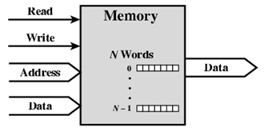
Memory Connection
TR 1. 3.3
Receives and sends data
Receives addresses (of locations)
Receives control signals
  Read
  Write
  Timing

Slide 22
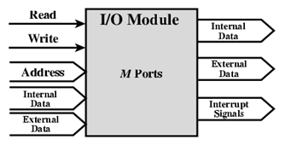
Input/Output Connection(1)
TR 1. 3.4
Similar to memory from computer’s viewpoint
Output
  Receive data from computer
  Send data to peripheral
Input
  Receive data from peripheral
  Send data to computer

Slide 23
Input/Output Connection(2)
TR 1. 3.5
Receive control signals from computer
Send control signals to peripherals
  e.g. spin disk
Receive addresses from computer
  e.g. port number to identify peripheral
Send interrupt signals (control)

Slide 24
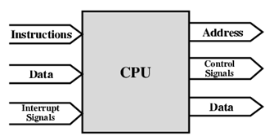
CPU Connection
TR 1. 3.6
Reads instruction and data
Writes out data (after processing)
Sends control signals to other units
Receives (& acts on) interrupts

Slide 25
BUS INTERCONNECTION
TR 1. 3.7
What is a Bus?
A communication pathway connecting two or more devices
Key characteristics – shared transmission medium
Multiple devices connect to the bus, and a signal transmitted by one device is available for reception by all other devices attached to the bus
If two devices transmit during the same time period, their signals will overlap and become garbled.
Thus, only one device at a time can successfully transmit
Often grouped
  A number of channels in one bus
  e.g. 32 bit data bus is 32 separate single bit channels

Slide 26
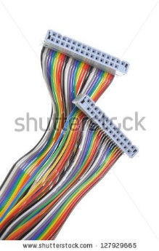
Data Bus
TR 1. 3.8
It may consists of from 32 to hundreds of separate lines, the number of lines being referred to as the width of the data bus
Each line carry only 1 bit at a time, the number of lines determines how many bits can be transferred at a time
The width of a data bus is a key determinant of system performance
  8, 16, 32, 64 bit
Cable Computer Bus Plug

Slide 27
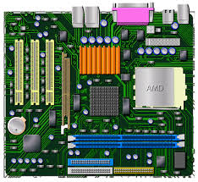
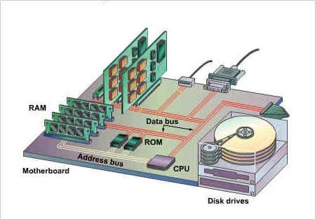
Motherboard
Data Bus and Address Bus

Slide 28
Address bus
TR 1. 3.9
Identify the source or destination of data on the data bus
e.g. CPU needs to read an instruction (data) from a given location in memory
Bus width determines maximum memory capacity of system
  e.g. 8080 has 16 bit address bus giving 64k address space

Slide 29
Control Bus
TR 1. 3.10
used to control the access to and the use of the data and address lines
Because the data and address line are shared by all components, there must be a means of controlling their use

Slide 30

Bus Interconnection Scheme
TR 1. 3.11

